Slide 1
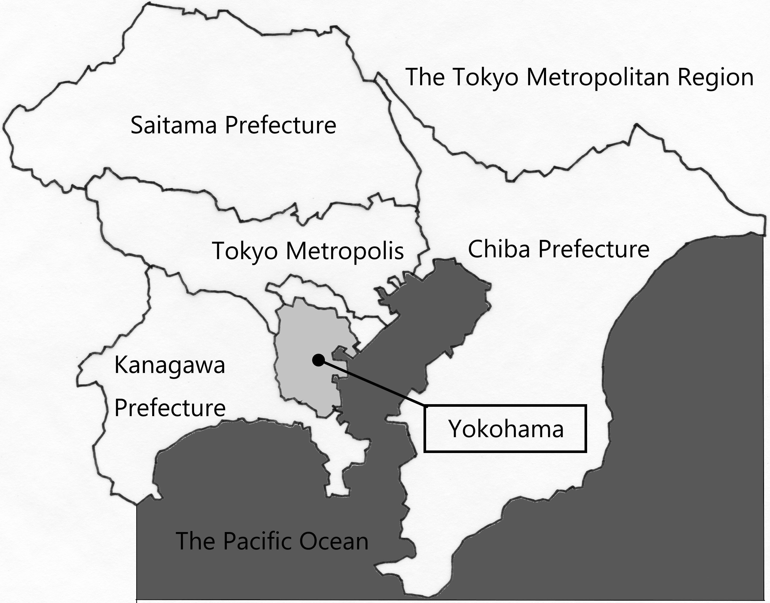
Motorway Undergrounding Projects in the 1960s: Coordinative Mechanism of City Administration in Yokohama
Toshio Taguchi, Akira Tamura Memorial-A Town Planning Research Initiative NPO, Yokohama, Japan.

Slide 2
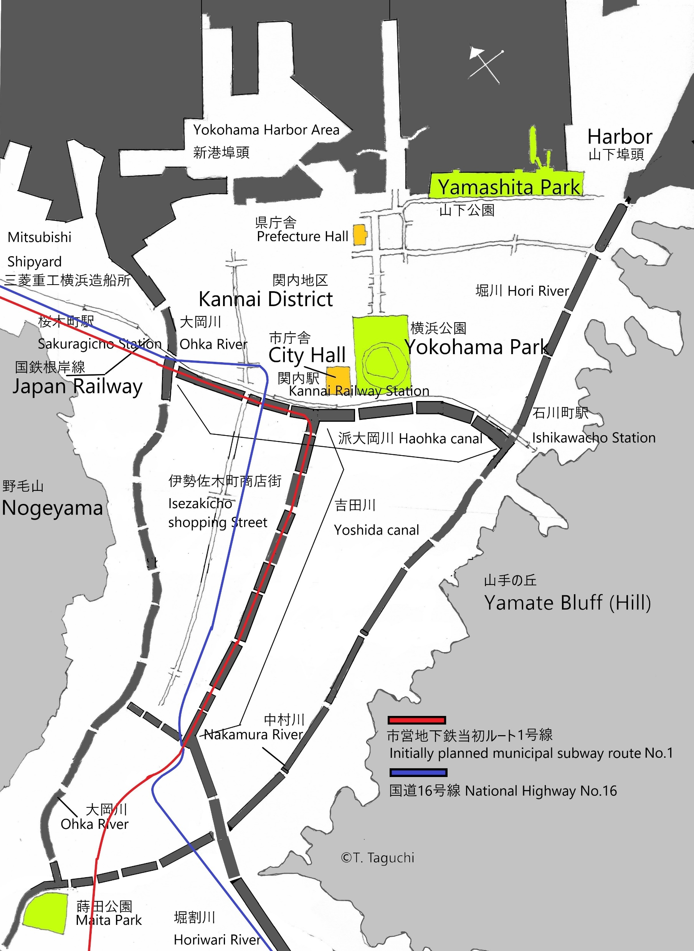
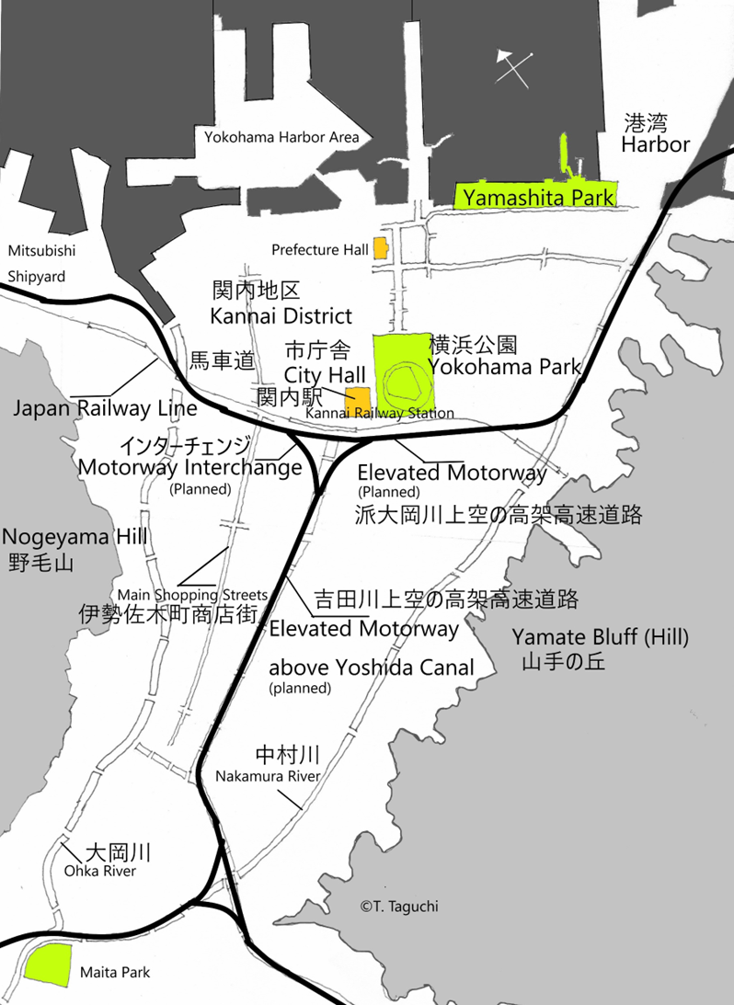

Slide 3
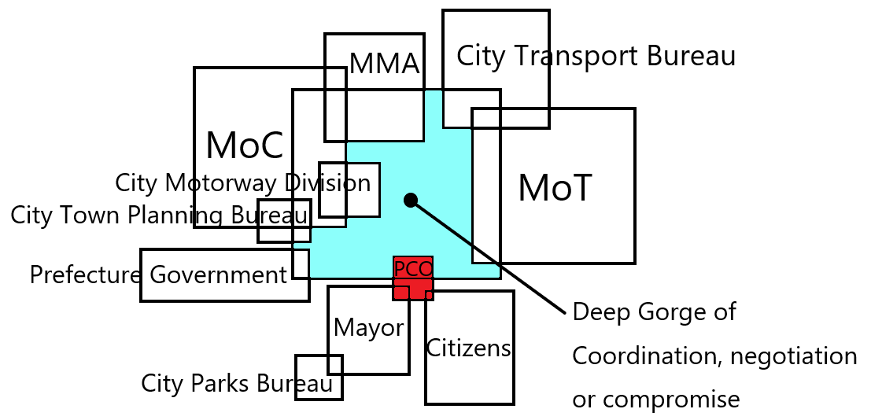
month | meetings
June | 1
July | 4
August | 19
September | 14
October | 3
November | 7
December | 7
January | 10
February | 64
March | 22
April | 37
Total | 188
Complex coordination among various public bodies involved
Examine Coordinative Mechanism of this case
Verify the precise process of coordination
Find out factors of success in coordination

Slide 4
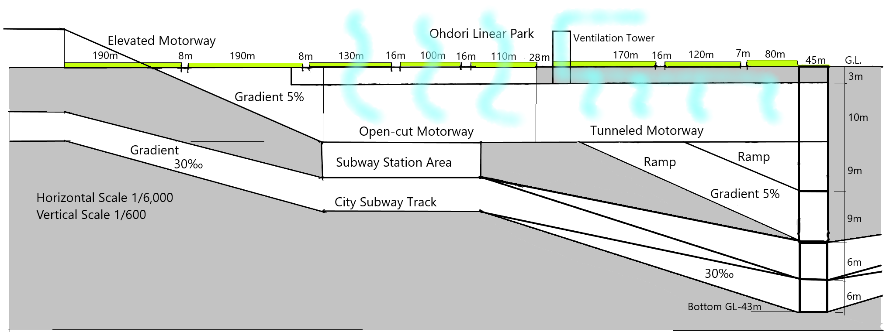
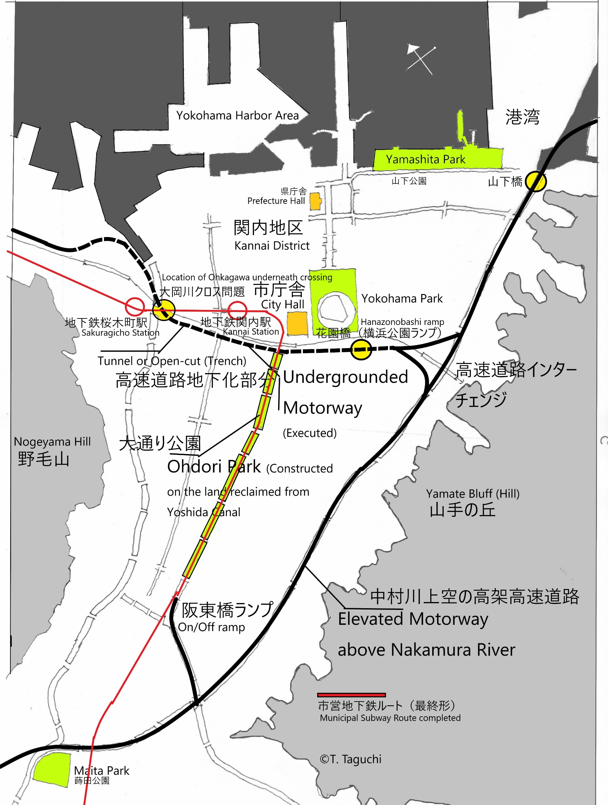
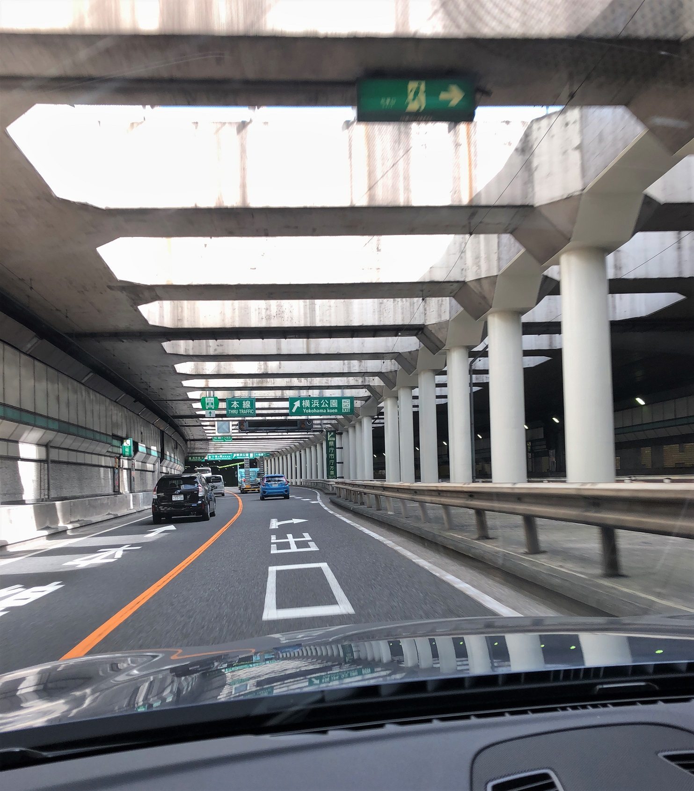
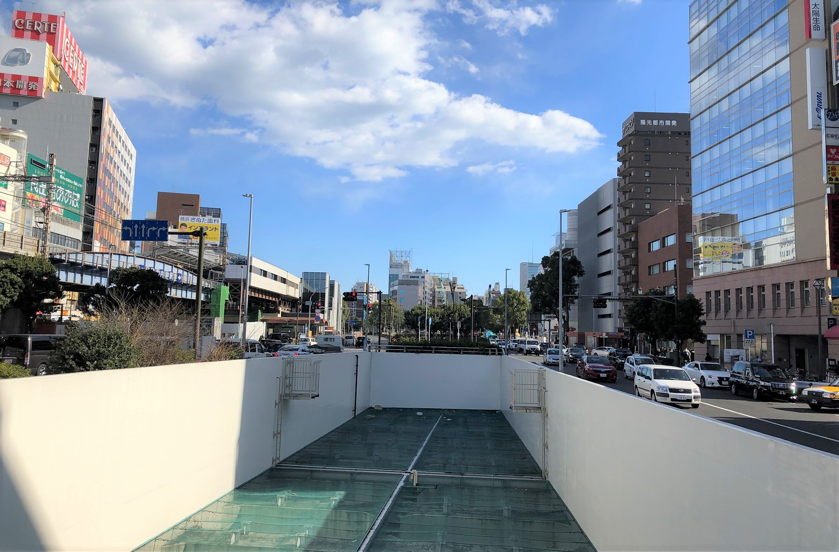
Undergrounded 2.3km in the city centre and Linear Park

Slide 5
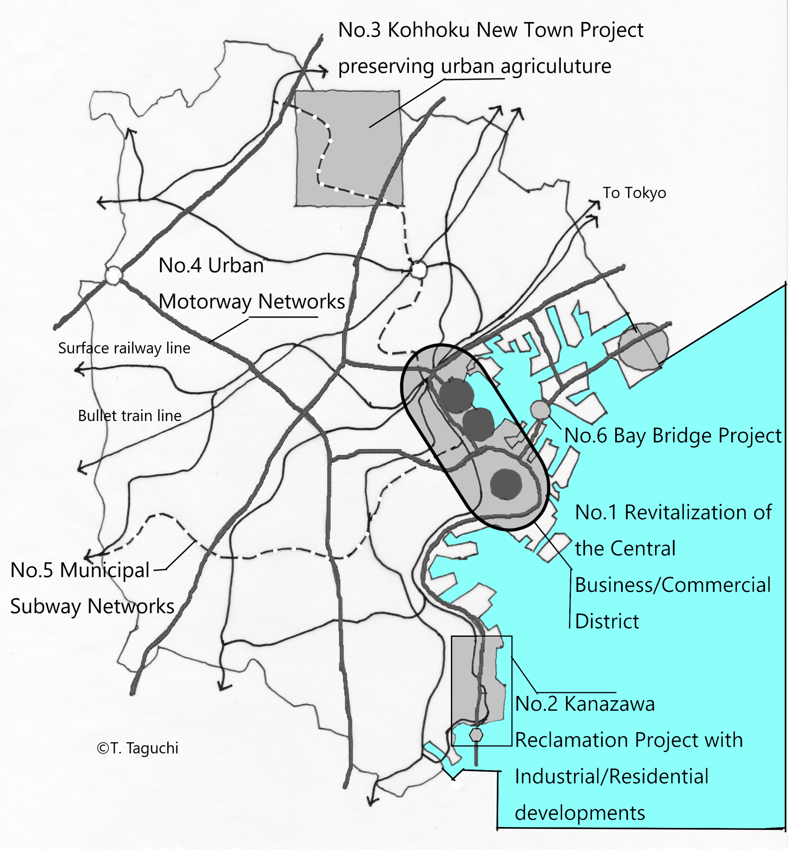
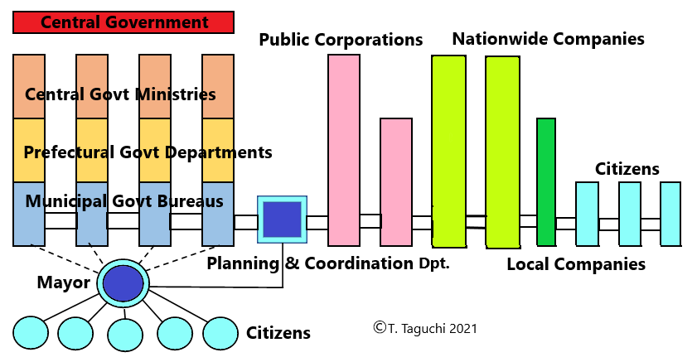
The Six Spine Projects by Akira Tamura
Concept of Planning and Coordination Function
Continuity of implementation of initial planning ideas and sustainable proactive administrative attitude in city administrations

